Slide 1
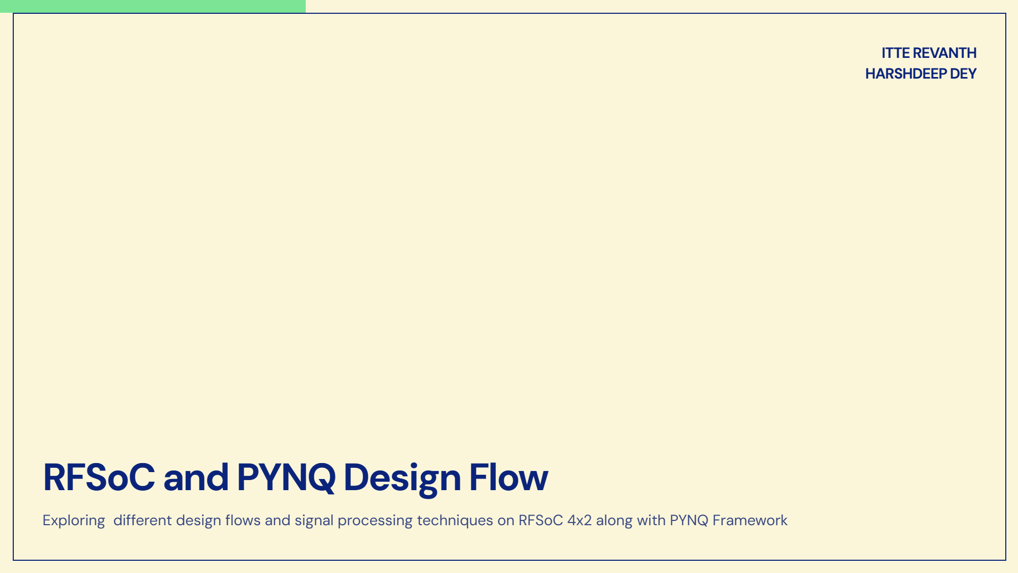
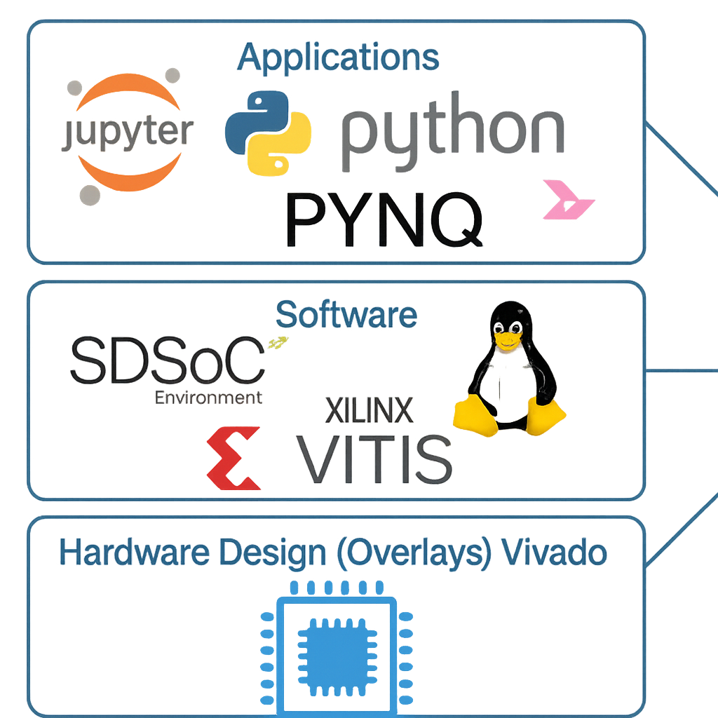
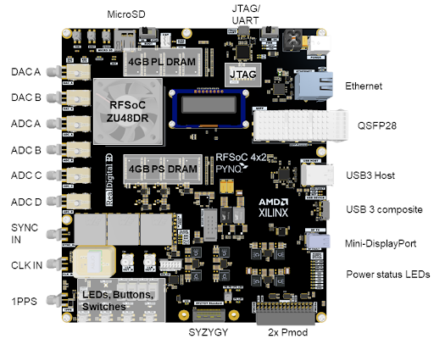

Slide 2
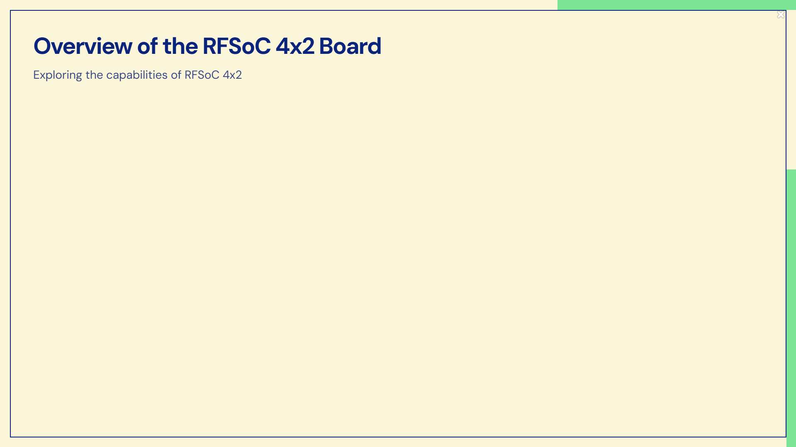
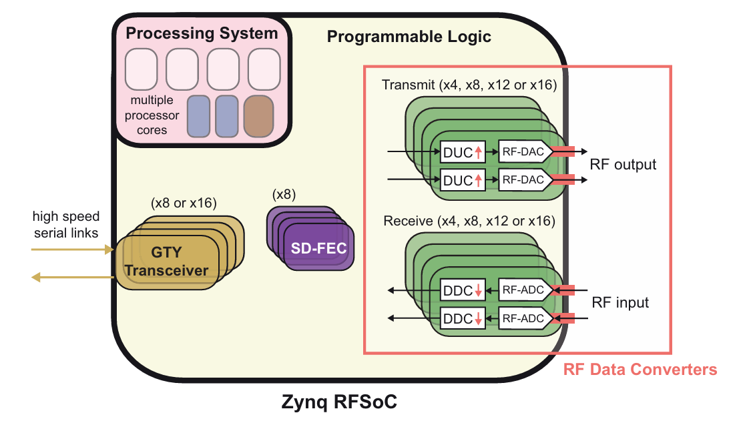
It integrates high-speed RF Data Converters (RFDCs), programmable logic (PL), and a powerful processing system (PS) on a single chip.
It has multi-GSps ADCs and DACs, enabling direct RF signal sampling and generation and built-in Digital Up/Down Converters (DUC/DDC).
The programmable logic allows implementation of custom radio architectures and supports runtime reconfiguration through software.
The processing system includes a quad-core application processor and dual-core real-time processor along with memory and peripherals to run OS, control hardware, and execute signal processing algorithms.
Fig 1 : RFSoC 4x2 Architecture

Slide 3

IP Generation
Vivado Block Design
Bitstream Generation
Dumping of Bitstream
PYNQ Driver Generation

Slide 4
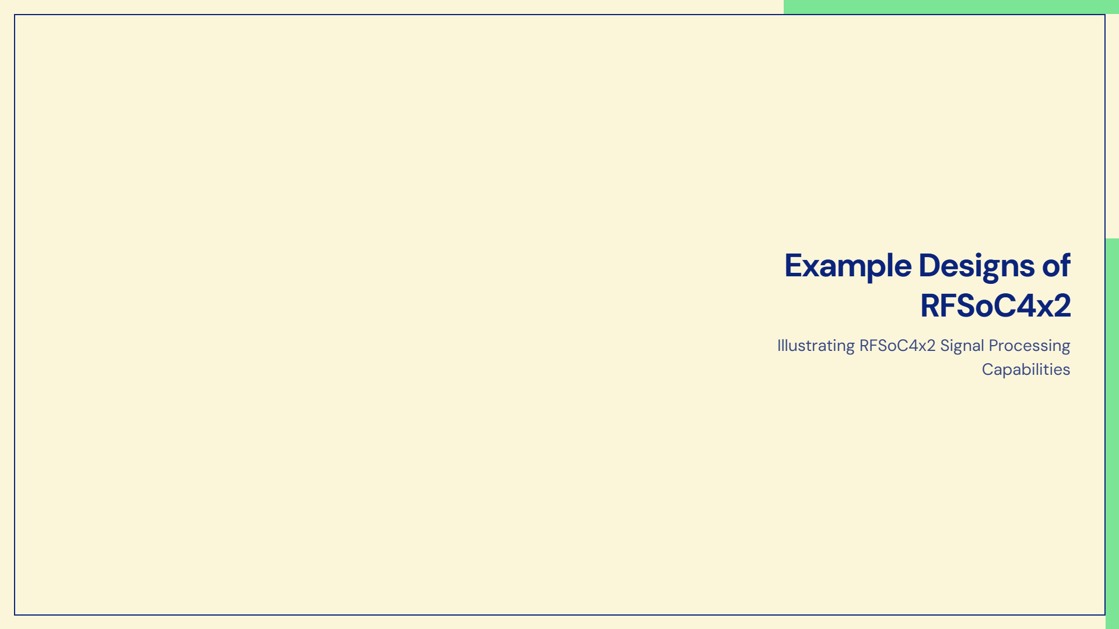
Interconnecting Slide Switches to On-Board LEDs via PL
Controlling On-Board LEDs from PS
Controlling Custom IP from PS through PYNQ Drivers

Slide 5
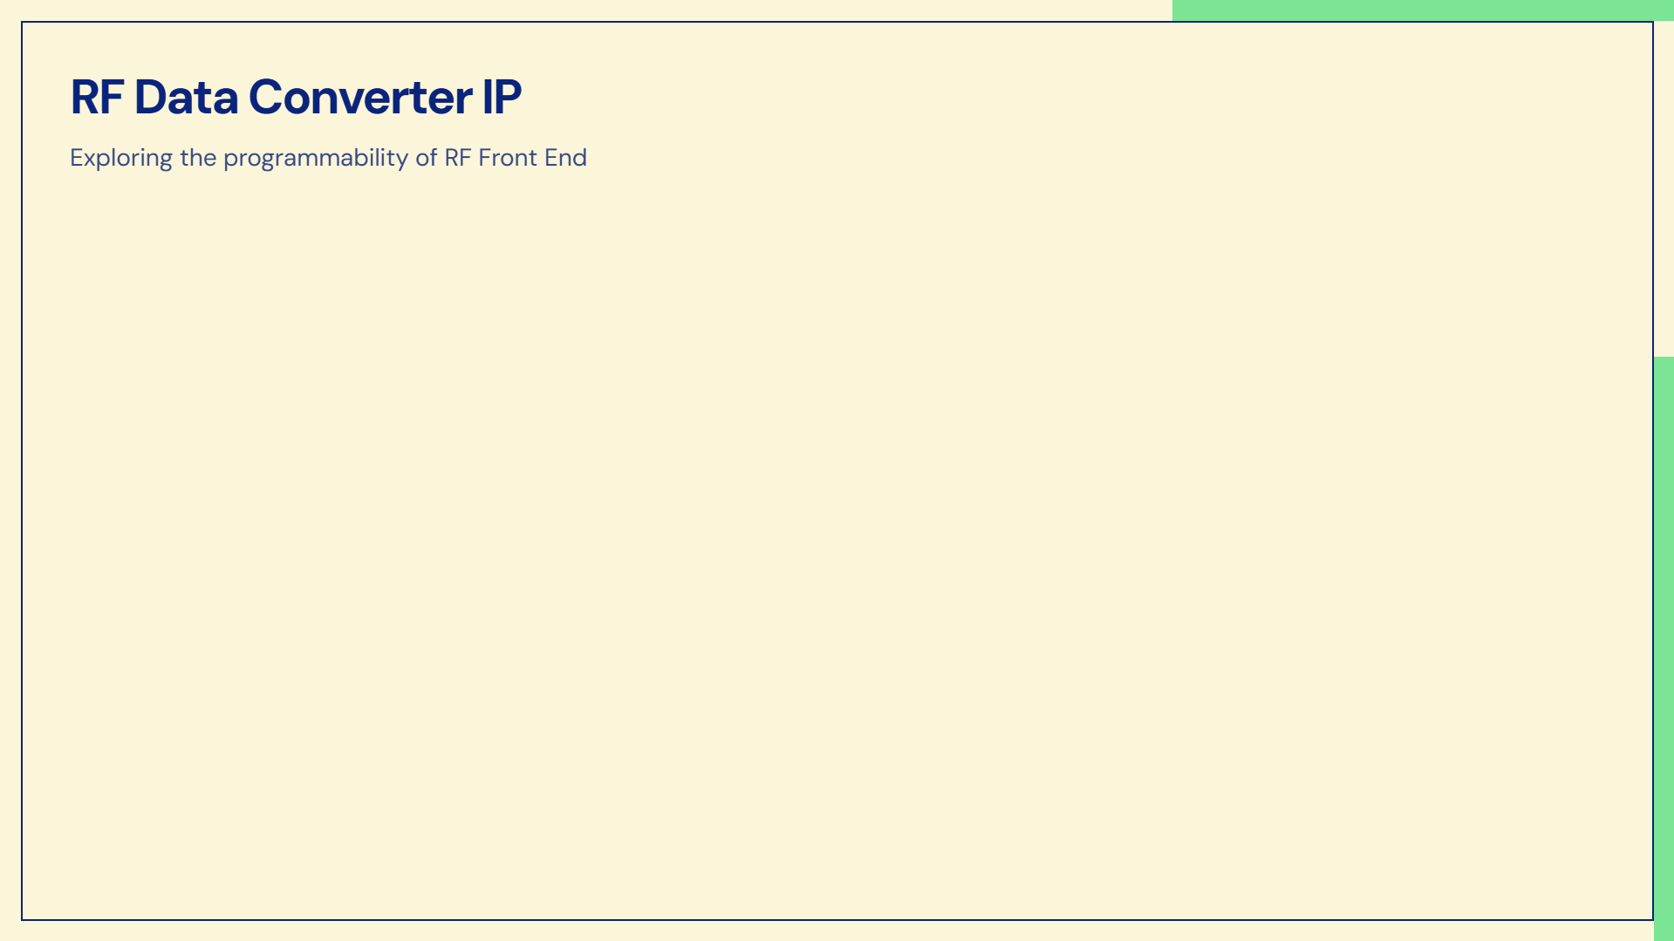
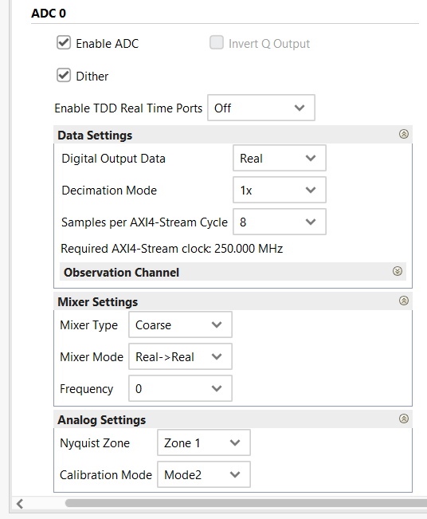
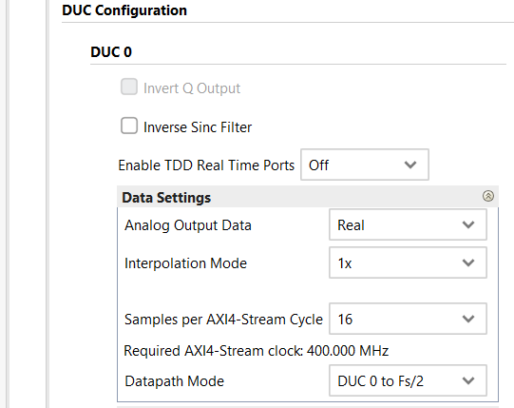
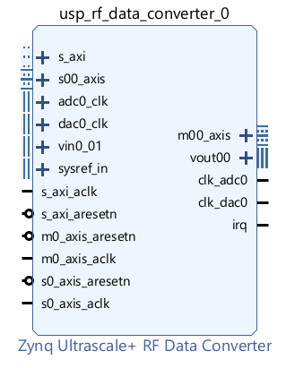
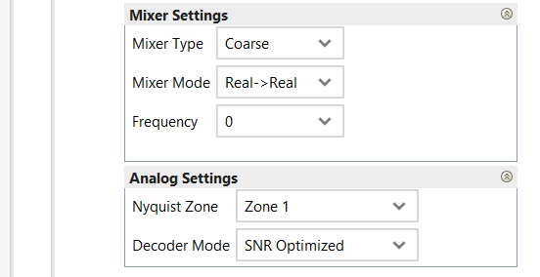

Slide 6
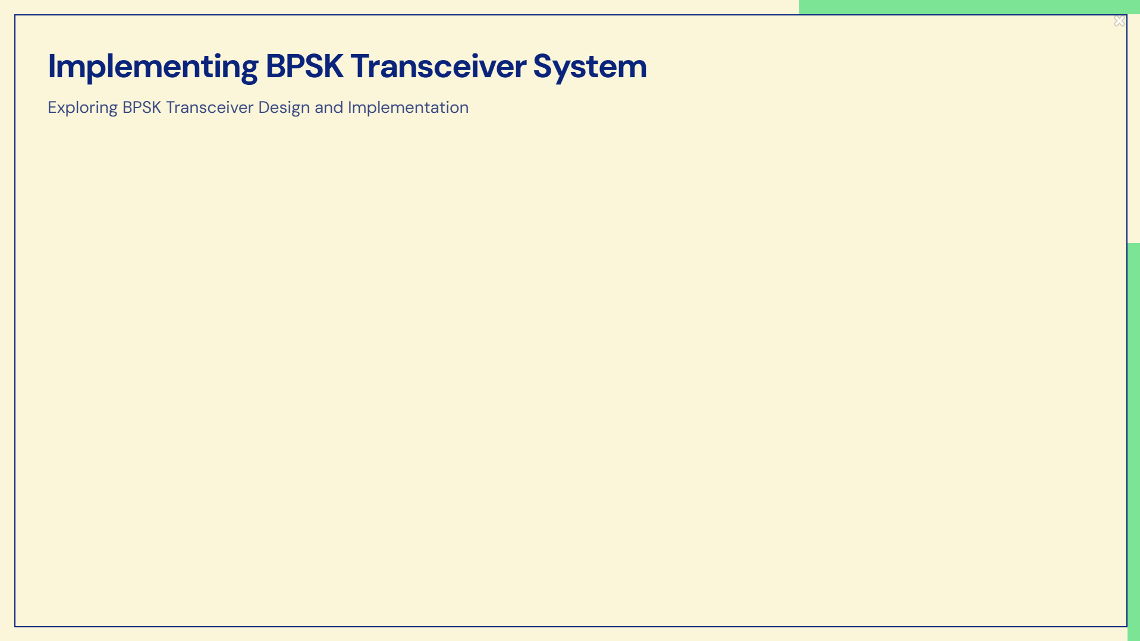
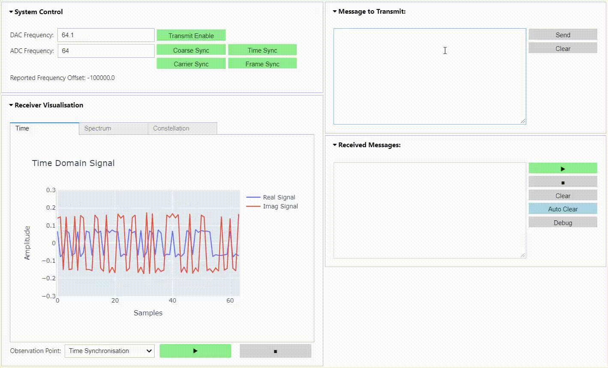

Slide 7
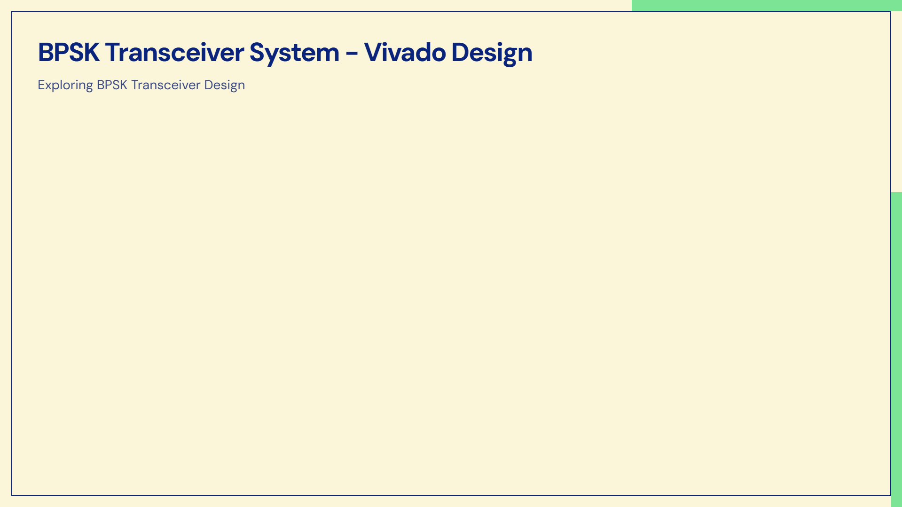
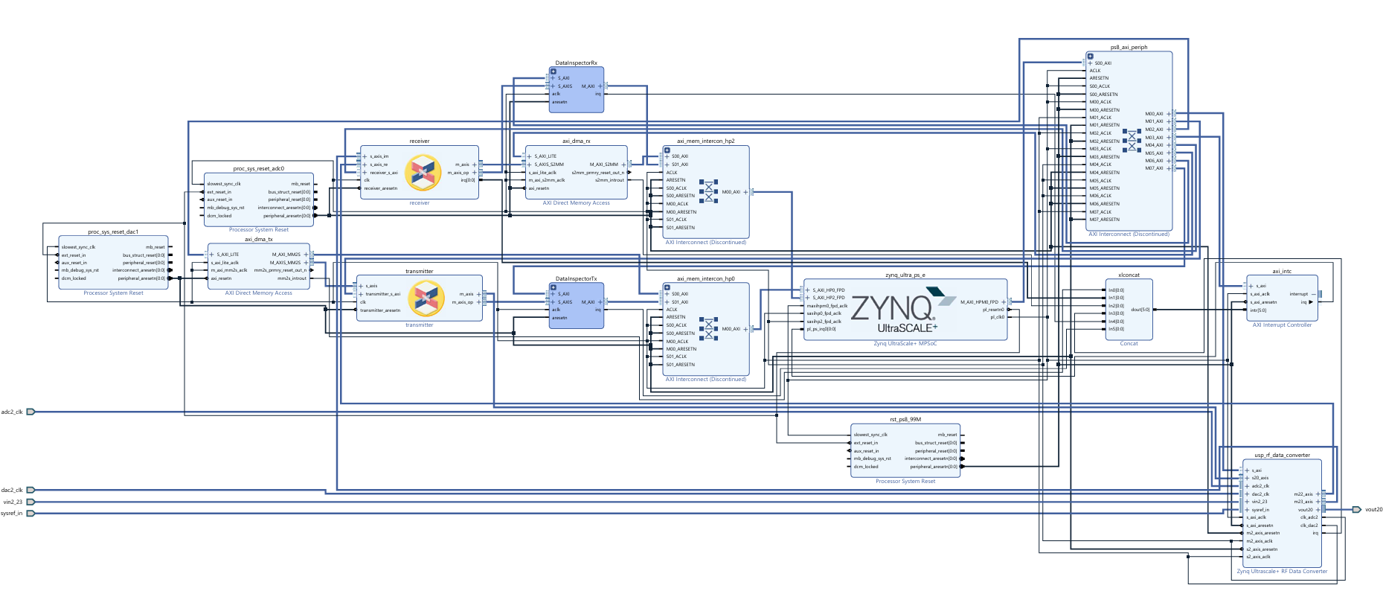

Slide 8


